Slide 1
PYTHON PROJECT ON CRIMINALS RECORD
BY
SALONI JAIN – A-14
VIKAS RARIA – B-27
SHAKTI – B-29

Slide 2
OBJECTIVE /AIM OF PROJECT:
Display all the records of criminals .
This project displays the records of criminals including their name, age, crime, father’s name, city, mobile number and so on.
We have made this presentation to introduce our project making techniques and the used syntax.

Slide 3
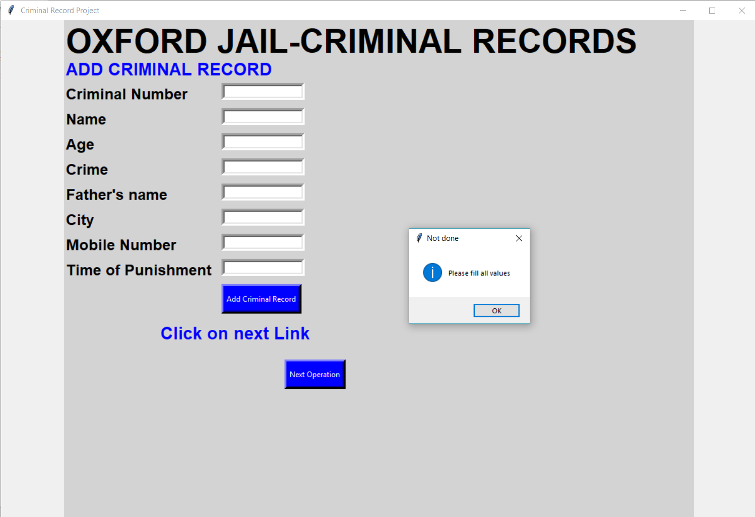
GUI INTERFACE - tkinter
The Gui (Graphical User Interface) is the major source of this project.
We have created a GUI of a jail using tkinter library.
Tkinter is the easy library of python to make a simple GUI interface.

Slide 4
OOP TERMINOLOGY
Python has been an object-oriented language since it existed. Because of this, creating and using classes and objects are downright easy. This chapter helps you become an expert in using Python's object-oriented programming support.
By creating classes and objects the project will become easier to understand.
We have used two classes in our project program named as Criminal and Criminal1 which simply add, update, search and delete a record from database Table named as Criminals.
The object of classes directly access the whole Gui interface.

Slide 5
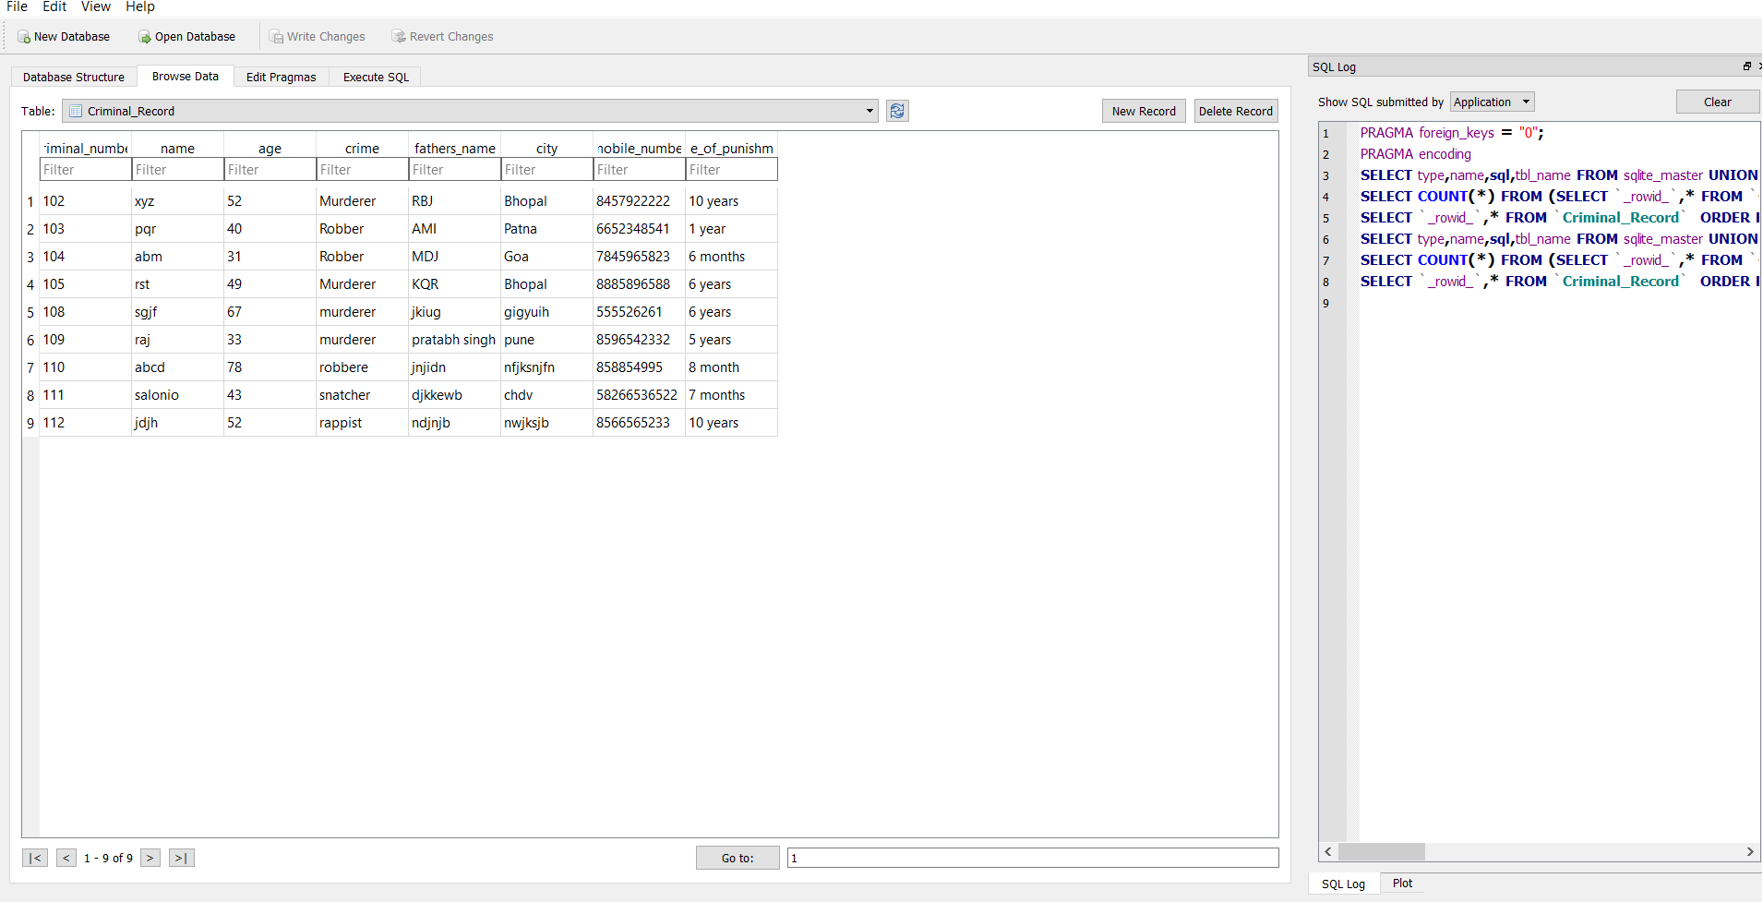
TABLE CRIMINALS IN SQLITE3 BROWSER

Slide 6
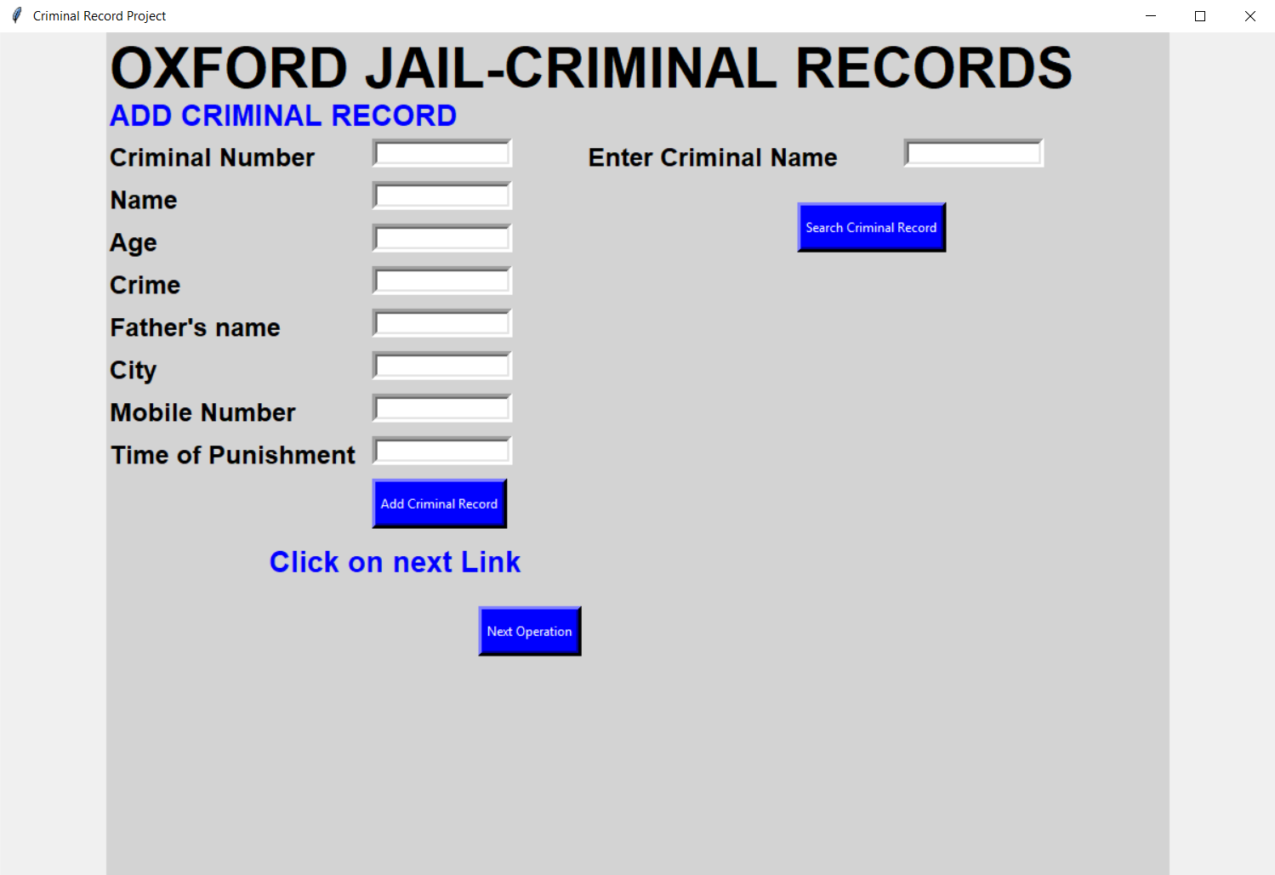
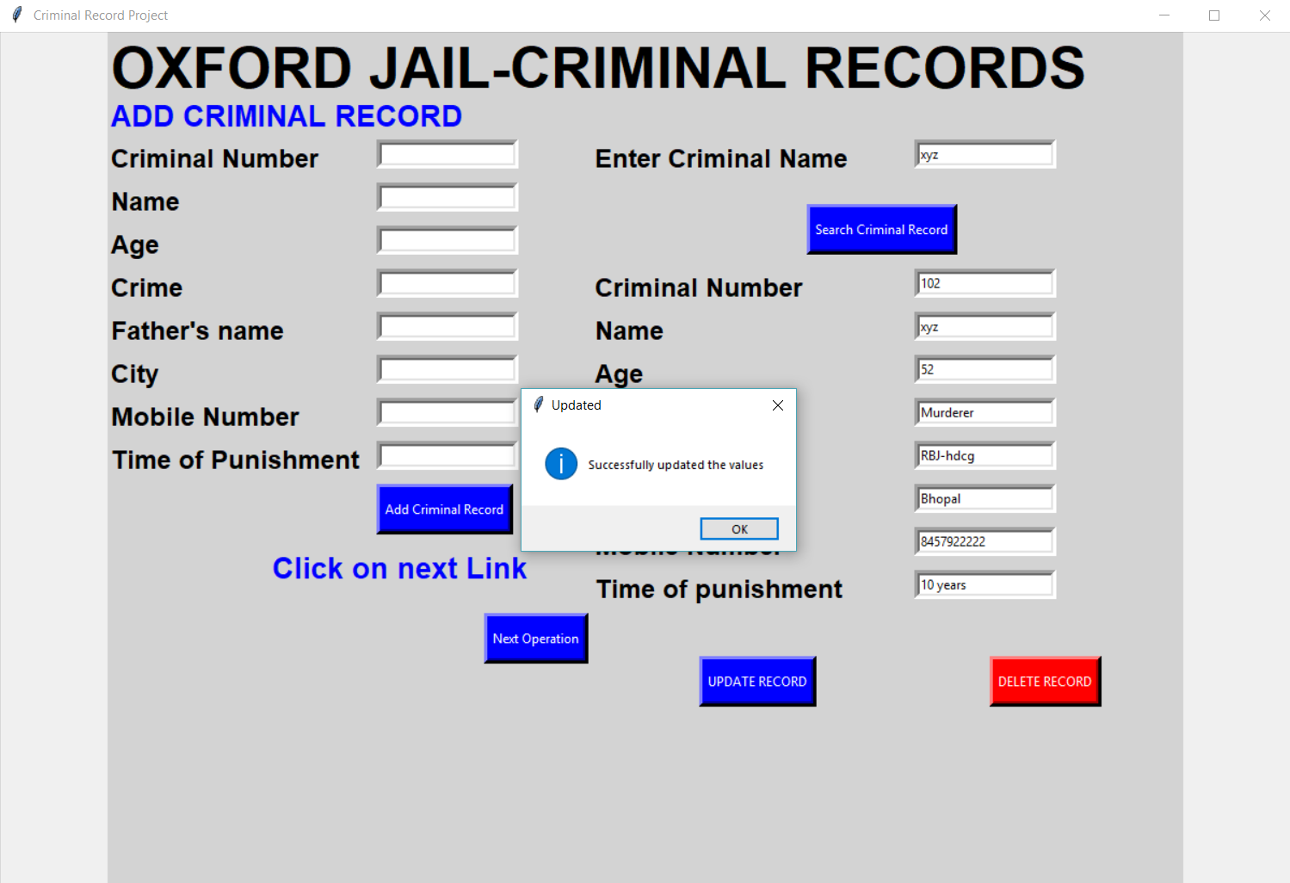
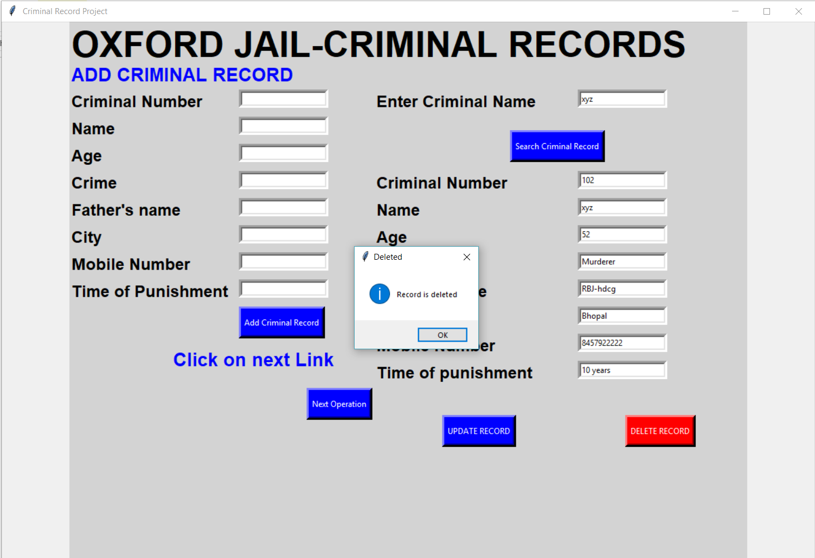

Slide 7
RESULT
The result of this project is using different logic and tkinter Gui interface a record for a new type of project which stores the data of criminal has been created.
The source code and the Gui will be discussed in class .

Slide 8
Thankyou

